Slide 1


OBJECT ORIENTED PROGRAMMING THROUGH JAVA
MODULE-5
PACKAGES AND EXCEPTION HANDLING

Slide 2
Packages:
Package in Java is a mechanism to encapsulate a group of classes, sub packages and interfaces.
Packages are used for:
Preventing naming conflicts, For example there can be two classes with name Employee in two packages, college.staff.cse.Employee and college.staff.ee.Employee
Making searching/locating and usage of classes, interfaces, enumerations and annotations easier
Providing controlled access: protected and default have package level access control. A protected member is accessible by classes in the same package and its subclasses. A default member (without any access specifier) is accessible by classes in the same package only.
Packages can be considered as data encapsulation (or data-hiding).

Slide 3
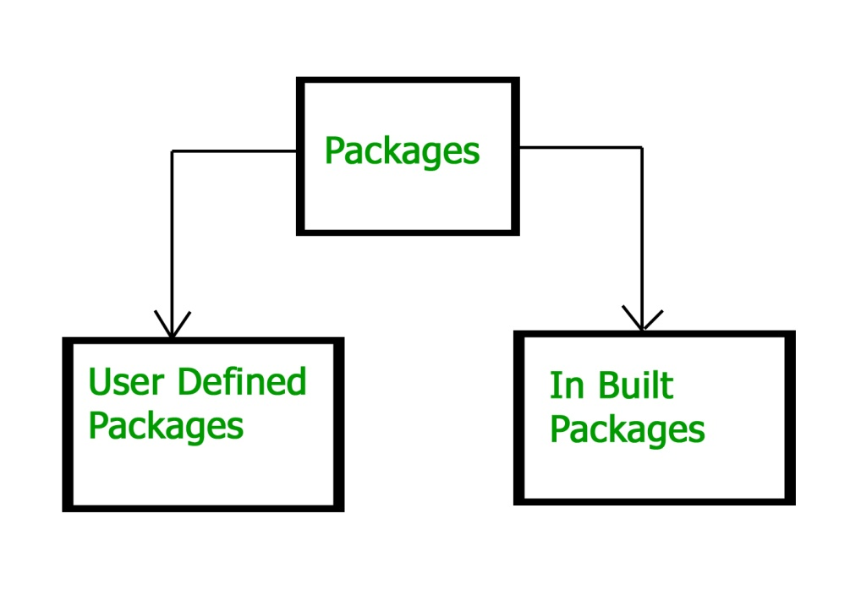
Types of packages:
Built-in Packages
These packages consist of a large number of classes which are a part of Java API.Some of the commonly used built-in packages are:
1) java.lang: Contains language support classes(e.g classed which defines primitive data types, math operations). This package is automatically imported.
2) java.io: Contains classed for supporting input / output operations.
3) java.util: Contains utility classes which implement data structures like Linked List, Dictionary and support ; for Date / Time operations.
4) java.applet: Contains classes for creating Applets.
5) java.awt: Contain classes for implementing the components for graphical user interfaces (like button , ;menus etc).
6) java.net: Contain classes for supporting networking operations

Slide 4
User-defined packages
These are the packages that are defined by the user. First we create a directory myPackage (name should be same as the name of the package). Then create the MyClass inside the directory with the first statement being the package names.
The package keyword is used to create a package in java.
//save as Simple.java
package mypack;
public class Simple{
public static void main(String args[]){
System.out.println("Welcome to package");
}
}
Output:
Welcome to package
How to run java package program
You need to use fully qualified name e.g. mypack.Simple etc to run the class.
To Compile: javac -d . Simple.java
To Run : java mypack.Simple
The -d is a switch that tells the compiler where to put the class file i.e. it represents destination. The . represents the current folder.

Slide 5
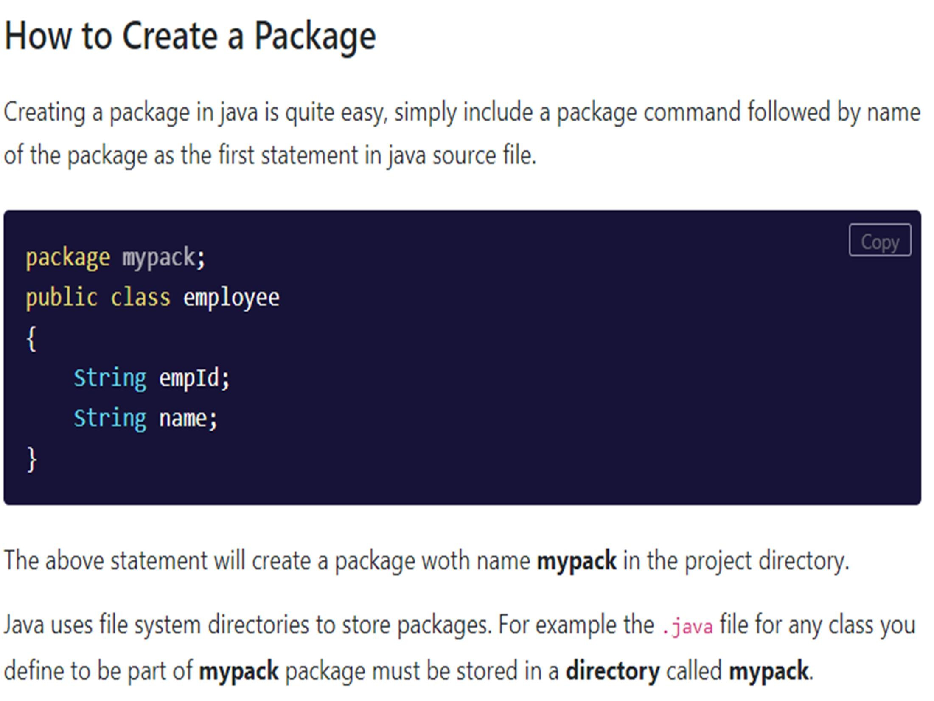

Slide 6
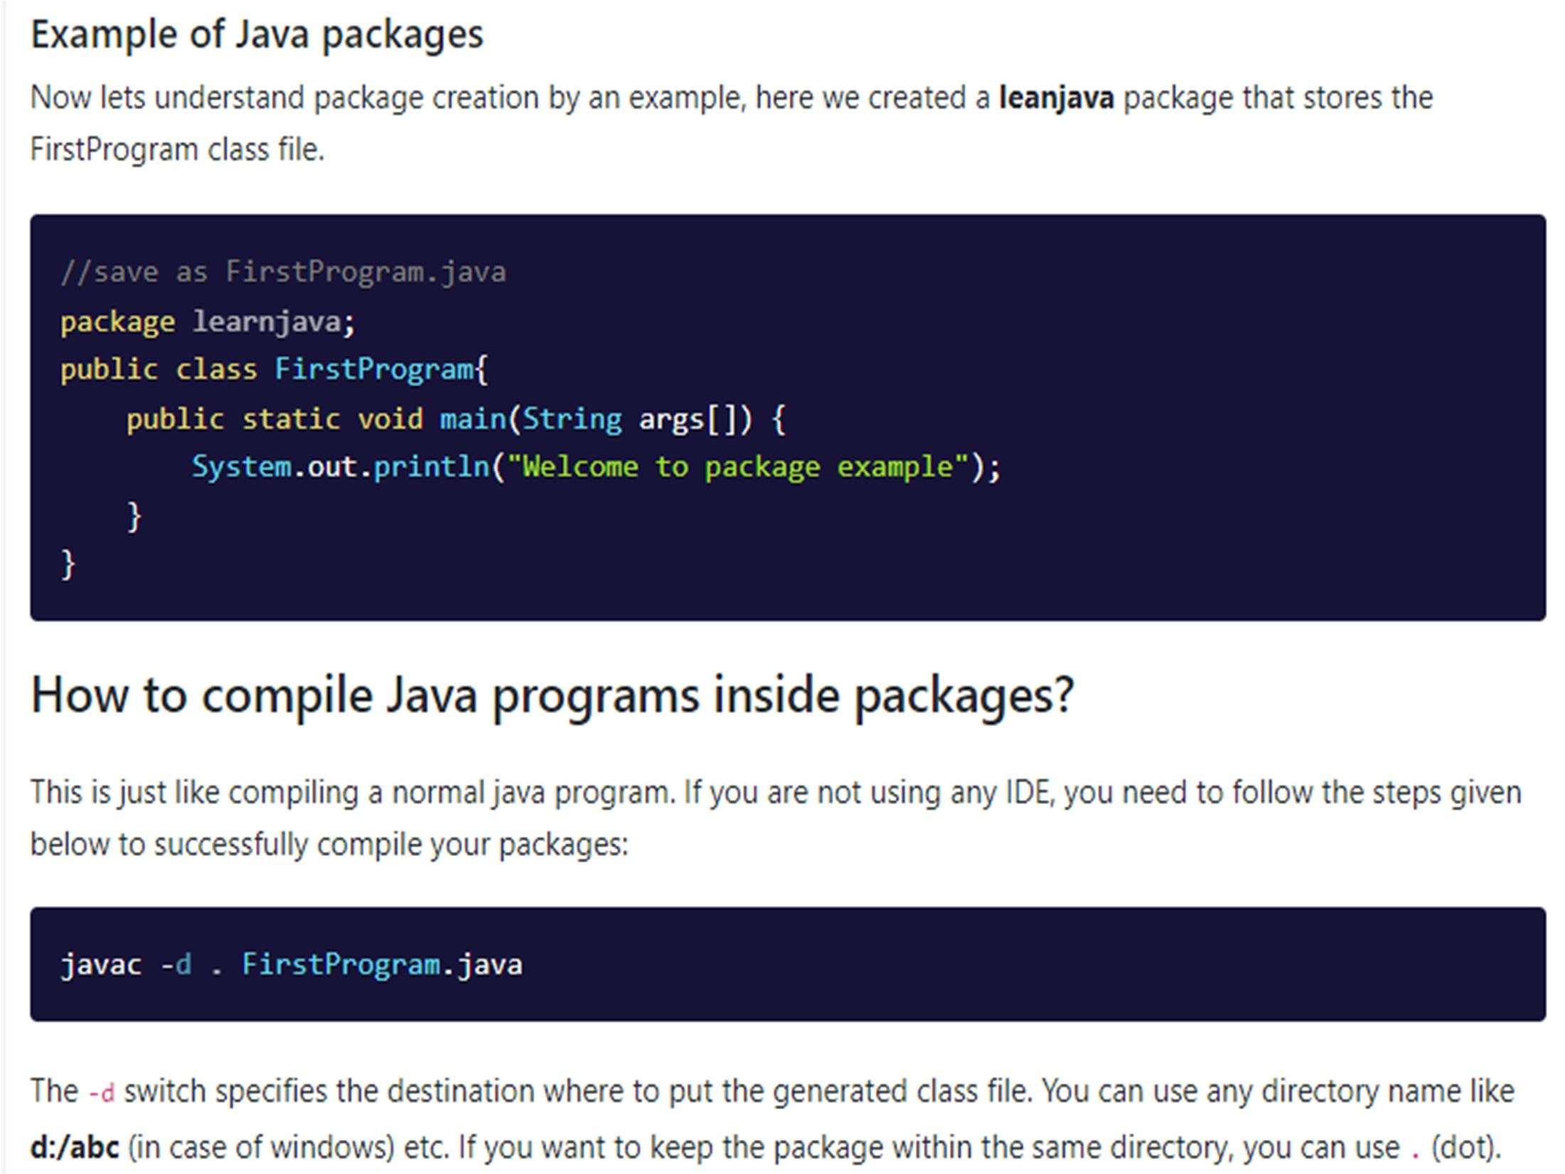

Slide 7
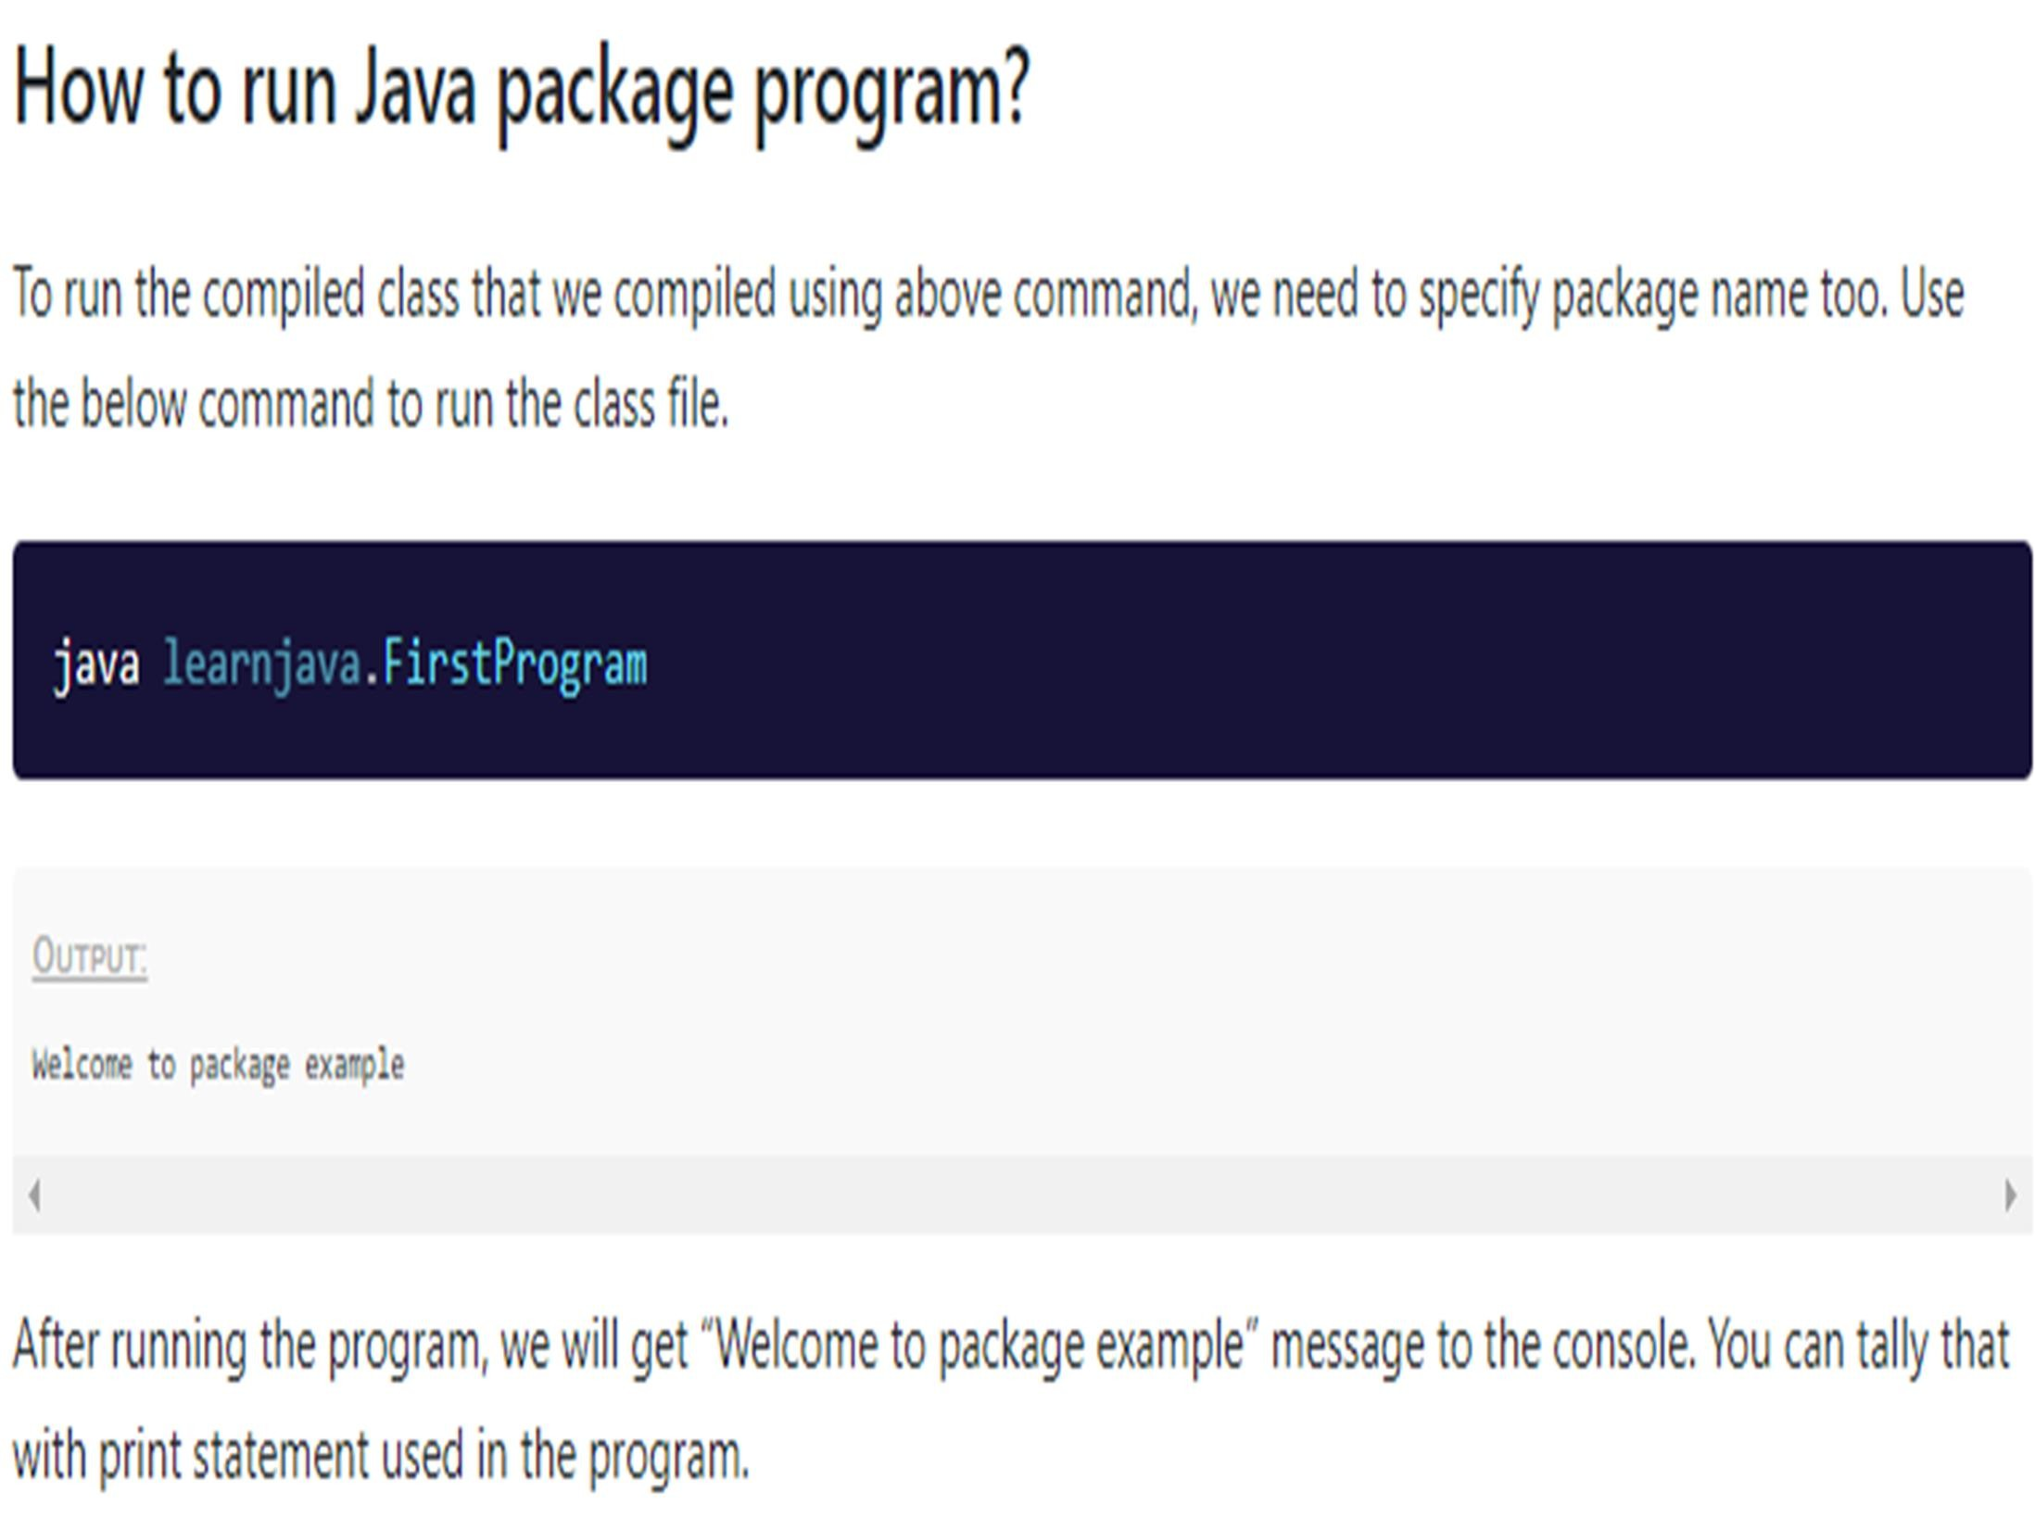

Slide 8
Member Access :
In Java, access modifiers are used to set the accessibility (visibility) of classes, interfaces, variables, methods, constructors, data members, and the setter methods.
For example,
class Animal
{
public void method1()
{...}
private void method2()
{...}
}
In the above example, we have declared 2 methods: method1() and method2().
Here,
method1 is public - This means it can be accessed by other classes.
method2 is private - This means it can not be accessed by other classes.

Slide 9
Types of Access Modifier
Before you learn about types of access modifiers, make sure you know about Java Packages.
There are four access modifiers keywords in Java and they are:
Modifier | Description
Default | declarations are visible only within the package (package private)
Private | declarations are visible within the class only
Protected | declarations are visible within the package or all subclasses
Public | declarations are visible everywhere

Slide 10
Default Access Modifier
If we do not explicitly specify any access modifier for classes, methods, variables, etc, then by default the default access modifier is considered. For example,
package defaultPackage;
class Logger
{
void message()
{ System.out.println("This is a message");
}
}
Here, the Logger class has the default access modifier. And the class is visible to all the classes that belong to the defaultPackage package. However, if we try to use the Logger class in another class outside of defaultPackage, we will get a compilation error.

Slide 11
Private Access Modifier
When variables and methods are declared private, they cannot be accessed outside of the class.
For example,
class Data
{
// private variable
private String name;
}
public class Main
{ public static void main(String[] main)
{
// create an object of Data
Data d = new Data();
// access private variable and field from another class
d.name = "Programiz";
}
}
In the above example, we have declared a private variable named name and a private method named display(). When we run the program, we will get the following error:
Main.java:18: error: name has private access in Data
d.name = "Programiz";

Slide 12
Private Access Modifier Example:
if we need to access those private variables. In this case, we can use the getters and setters method. For example,
class Data {
private String name;
// getter method
public String getName() {
return this.name;
}
// setter method
public void setName(String name) {
this.name= name;
}
}
public class Main {
public static void main(String[] main){
Data d = new Data();
// access the private variable using the getter and setter
d.setName("Programiz");
System.out.println(d.getName());
}
}

Slide 13
Protected Access Modifier
When methods and data members are declared protected, we can access them within the same package as well as from subclasses. For example,
class Animal {
// protected method
protected void display() {
System.out.println("I am an animal");
}
}
class Dog extends Animal {
public static void main(String[] args) {
// create an object of Dog class
Dog dog = new Dog();
// access protected method
dog.display();
}
}
Note: We cannot declare classes or interfaces protected in Java.

Slide 14
Public Access Modifier
When methods, variables, classes, and so on are declared public, then we can access them from anywhere. The public access modifier has no scope restriction. For example,
public class Animal {
public int legCount;
public void display() {
System.out.println("I am an animal.");
System.out.println("I have " + legCount + " legs.");
}
}
public class Main {
public static void main( String[] args ) {
// accessing the public class
Animal animal = new Animal();
// accessing the public variable
animal.legCount = 4;
// accessing the public method
animal.display();
}
}
.
Output:
I am an animal.
I have 4 legs

Slide 15
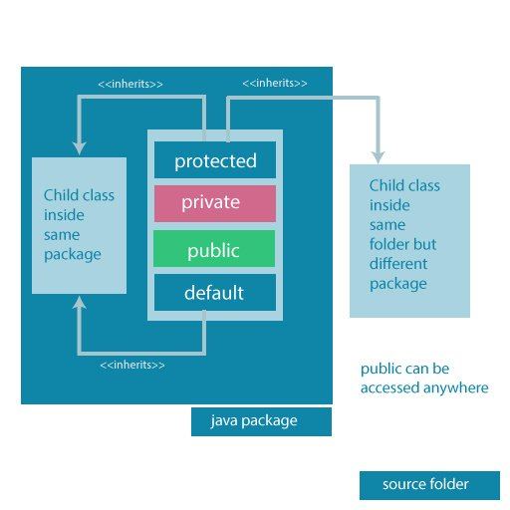
Access Modifiers Summarized in one figure
Access modifiers are mainly used for encapsulation. I can help us to control what part of a program can access the members of a class. So that misuse of data can be prevented.

Slide 16
Importing Packages in java:
In java, the import keyword used to import built-in and user-defined packages. When a package has imported, we can refer to all the classes of that package using their name directly.
The import statement must be after the package statement, and before any other statement.
Using an import statement, we may import a specific class or all the classes from a package.
🔔 Using one import statement, we may import only one package or a class.
🔔 Using an import statement, we can not import a class directly, but it must be a part of a package.
🔔 A program may contain any number of import statements.

Slide 17
Importing packages:
There are three ways to access the package from outside the package.
1.import package.*;
2.import package.classname;
3.fully qualified name.
Using packagename.*
If you use package.* then all the classes and interfaces of this package will be accessible but not subpackages. The import keyword is used to make the classes and interface of another package accessible to the current package.
//save by A.java
package pack;
public class A{
public void msg(){System.out.println("Hello");}
}
//save by B.java
package mypack;
import pack.*;
class B{
public static void main(String args[]){
A obj = new A();
obj.msg();
}
}
Output:Hello
Example 2:import java.util.Scanner;

Slide 18
2) Using packagename.classname
If you import package.classname then only declared class of this package will be accessible.
//save by A.java
package pack;
public class A{
public void msg(){System.out.println("Hello");}
}
//save by B.java
package mypack;
import pack . A;
class B{
public static void main(String args[]){
A obj = new A();
obj.msg();
}
}
Output:Hello

Slide 19
3) Using fully qualified name:
If you use fully qualified name then only declared class of this package will be accessible. Now there is no need to import. But you need to use fully qualified name every time when you are accessing the class or interface.
It is generally used when two packages have same class name e.g. java.util and java.sql packages contain Date class.
//save by B.java
package mypack;
class B{
public static void main(String args[]){
pack.A obj = new pack.A();//using fully qualified name
obj.msg();
}
}
//save by A.java
package pack;
public class A{
public void msg(){System.out.println("Hello");}
}

Slide 20
Adding a class to a Package : We can add more classes to a created package by using package name at the top of the program and saving it in the package directory. We need a new java file to define a public class, otherwise we can add the new class to an existing .java file and recompile it.
Subpackages: Packages that are inside another package are the subpackages. These are not imported by default, they have to imported explicitly. Also, members of a subpackage have no access privileges, i.e., they are considered as different package for protected and default access specifiers.
Example :
import java.util.*;
util is a subpackage created inside java package
Accessing classes inside a package
Consider following two statements :
// import the Vector class from util package.
import java.util.vector;
// import all the classes from util package
import java.util.*;
First Statement is used to import Vector class from util package which is contained inside java.
Second statement imports all the classes from util package.

Slide 21
// All the classes and interfaces of this package
// will be accessible but not subpackages.
import package.*;
// Only mentioned class of this package will be accessible.
import package.classname;
// Class name is generally used when two packages have the same
// class name. For example in below code both packages have
// date class so using a fully qualified name to avoid conflict
import java.util.Date;
import my.packag.Date;
import java.util.Vector;
public class ImportDemo
{
public ImportDemo()
{
// java.util.Vector is imported, hence we are
// able to access directly in our code.
Vector newVector = new Vector();
// java.util.ArrayList is not imported, hence
// we were referring to it using the complete
// package.
java.util.ArrayList newList = new java.util.ArrayList();
}
public static void main(String arg[])
{
new ImportDemo();
}
}

Slide 22
Static import:
In Java, static import concept is introduced in 1.5 version. With the help of static import, we can access the static members of a class directly without class name or any object.
For Example:
we always use sqrt() method of Math class by using Math class i.e. Math.sqrt(), but by using static import we can access sqrt() method directly.
// Java Program to illustrate
// calling of predefined methods
// with static import
import static java.lang.Math.*;
class Test2 {
public static void main(String[] args)
{
System.out.println(sqrt(4));
System.out.println(pow(2, 2));
System.out.println(abs(6.3));
}
}
// Java Program to illustrate
// calling of predefined methods
// without static import
class Geeks {
public static void main(String[] args)
{
System.out.println(Math.sqrt(4));
System.out.println(Math.pow(2, 2));
System.out.println(Math.abs(6.3));
}
}

Slide 23
Advantage of static import:
Less coding is required if you have access any static member of a class oftenly.
Disadvantage of static import:
If you overuse the static import feature, it makes the program unreadable and unmaintainable.
Ambiguity in static import:
If two static members of the same name are imported from multiple different classes, the compiler will throw an error, as it will not be able to determine which member to use in the absence of class name qualification.
// Java program to illustrate
// ambiguity in case of
// static import
import static java.lang.Integer.*;
import static java.lang.Byte.*;
class Geeks {
public static void main(String[] args)
{
out.println(MAX_VALUE);
}
}

Slide 24
Exception Hierarchy:
The Exception Handling in Java is one of the powerful mechanism to handle the runtime errors so that the normal flow of the application can be maintained.
Exception Handling can handle runtime errors such as ClassNotFoundException, IOException, SQLException, RemoteException, etc.
In Java, an exception is an event that disrupts the normal flow of the program. It is an object which is thrown at runtime.
Advantage of Exception Handling
The core advantage of exception handling is to maintain the normal flow of the application. An exception normally disrupts the normal flow of the application; that is why we need to handle exceptions. Let's consider a scenario:
statement 1;
statement 2;
statement 3;
statement 4;
statement 5;//exception occurs
statement 6;
statement 7;
statement 8;
statement 9;
statement 10;
Suppose there are 10 statements in a Java program and an exception occurs at statement 5; the rest of the code will not be executed, i.e., statements 6 to 10 will not be executed. However, when we perform exception handling, the rest of the statements will be executed. That is why we use exception handling in Java

Slide 25
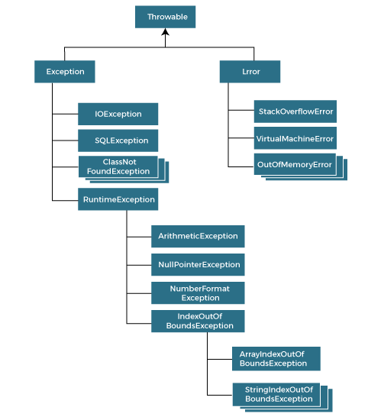
Hierarchy of Java Exception classes

Slide 26
Types of Java Exceptions
There are mainly two types of exceptions: checked and unchecked. An error is considered as the unchecked exception.
However, according to Oracle, there are three types of exceptions namely:
  Checked Exception
  Unchecked Exception
  Error
1) Checked Exception
The classes that directly inherit the Throwable class except RuntimeException and Error are known as checked exceptions. For example, IOException, SQLException, etc. Checked exceptions are checked at compile-time.
2) Unchecked Exception
The classes that inherit the RuntimeException are known as unchecked exceptions. For example, ArithmeticException, NullPointerException, ArrayIndexOutOfBoundsException, etc. Unchecked exceptions are not checked at compile-time, but they are checked at runtime.
3) Error
Error is irrecoverable. Some example of errors are OutOfMemoryError, VirtualMachineError, AssertionError etc.

Slide 27
Java Exception Keywords
Java provides five keywords that are used to handle the exception. The following table describes each.
Keyword | Description
try | The "try" keyword is used to specify a block where we should place an exception code. It means we can't use try block alone. The try block must be followed by either catch or finally.
catch | The "catch" block is used to handle the exception. It must be preceded by try block which means we can't use catch block alone. It can be followed by finally block later.
finally | The "finally" block is used to execute the necessary code of the program. It is executed whether an exception is handled or not.
throw | The "throw" keyword is used to throw an exception.
throws | The "throws" keyword is used to declare exceptions. It specifies that there may occur an exception in the method. It doesn't throw an exception. It is always used with method signature.

Slide 28
Java Exception Handling Example
Let's see an example of Java Exception Handling in which we are using a try-catch statement to handle the exception
Example:
public class JavaExceptionExample{
public static void main(String args[]){
try{
//code that may raise exception
int data=100/0;
}catch(ArithmeticException e){System.out.println(e);}
//rest code of the program
System.out.println("rest of the code...");
}
}
Output:
Exception in thread main java.lang.ArithmeticException:/ by zero rest of the code...

Slide 29
Common Scenarios of Java Exceptions
There are given some scenarios where unchecked exceptions may occur. They are as follows:
1) A scenario where ArithmeticException occurs
If we divide any number by zero, there occurs an ArithmeticException.
int a=50/0;//ArithmeticException
2) A scenario where NullPointerException occurs
If we have a null value in any variable
, performing any operation on the variable throws a NullPointerException.
String s=null;
System.out.println(s.length());//NullPointerException
3) A scenario where NumberFormatException occurs
If the formatting of any variable or number is mismatched, it may result into NumberFormatException. Suppose we have a string
variable that has characters; converting this variable into digit will cause NumberFormatException.
String s="abc";
int i=Integer.parseInt(s);//NumberFormatException

Slide 30
4) A scenario where ArrayIndexOutOfBoundsException occurs
When an array exceeds to it's size, the ArrayIndexOutOfBoundsException occurs. there may be other reasons to occur ArrayIndexOutOfBoundsException. Consider the following statements.
int a[]=new int[5];
a[10]=50; //ArrayIndexOutOfBoundsException

Slide 31
Consequences of an uncaught exception
In java, assume that, if we do not handle the exceptions in a program. In this case, when an exception occurs in a particular function, then Java prints a exception message with the help of uncaught exception handler.
The uncaught exceptions are the exceptions that are not caught by the compiler but automatically caught and handled by the Java built-in exception handler.
When an uncaught exception occurs, the JVM calls a special private method known dispatchUncaughtException( ), on the Thread class in which the exception occurs and terminates the thread.

Slide 32
The Division by zero exception is one of the example for uncaught exceptions. Look at the following code.
import java.util.Scanner;
public class UncaughtExceptionExample
{
public static void main(String[] args)
{
Scanner read = new Scanner(System.in);
System.out.println("Enter the a and b values: ");
int a = read.nextInt();
int b = read.nextInt();
int c = a / b;
System.out.println(a + "/" + b +" = " + c);
}
}

Slide 33
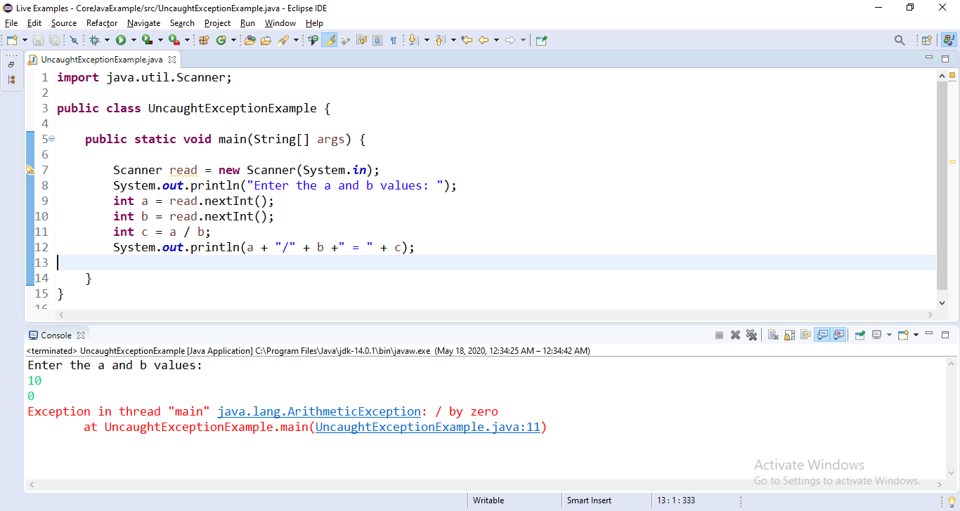
When we execute the above code, it produce the following output for the value a = 10 and b = 0.
In the above example code, we are not used try and catch blocks, but when the value of b is zero the division by zero exception occurs and it caught by the default exception handler.

Slide 34
Handling Error In Java
Error refers to an illegal operation performed by the user which results in the abnormal working of the program. Programming errors often remain undetected until the program is compiled or executed. Some of the errors inhibit the program from getting compiled or executed. Thus errors should be removed before compilingand executing. It is of three types:
Compile-time
Run-time
Logical

Slide 35
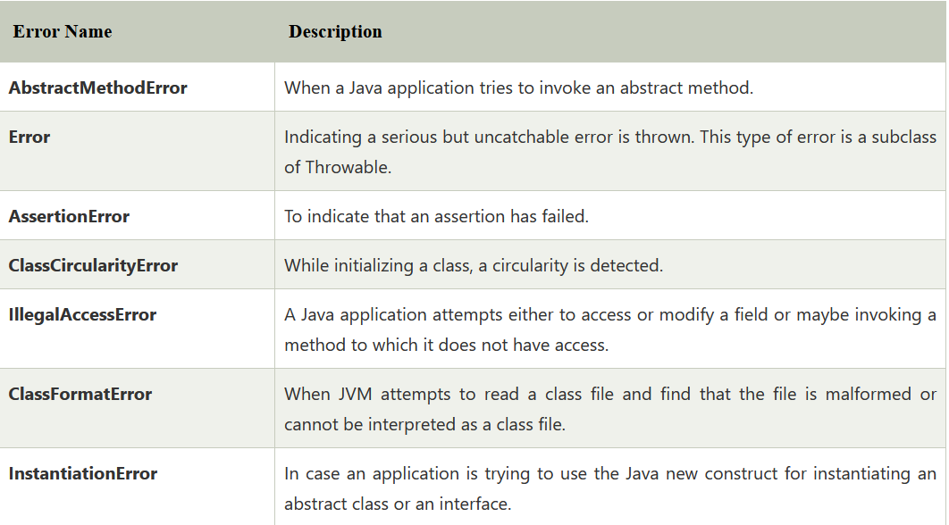
Certain Errors in Java
The Java.lang.Errors provide varieties of errors that are thrown under the lang package of Java. Some of the errors are:

Slide 36
Java Error Example
class StackExample {
public static void check(int i)
{
if (i == 0)
return;
else {
check(i++);
}
}
}
public class Main {
public static void main(String[] args)
{
StackExample.check(5);
}
}
In the above code, we have performed a program of Stack overflow.
In it, we have created a class, namely StackOverflow, within which designed a function that performs an infinite recursion.
Next, in the main class, we have invoked the function, and it results in infinite recursion.

Slide 37
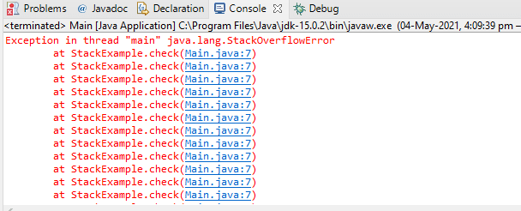
On executing the code, we got the below-shown output:
In order to stop the infinite execution, we may require to terminate the program because it will not be tackled by any normal condition.

Slide 38
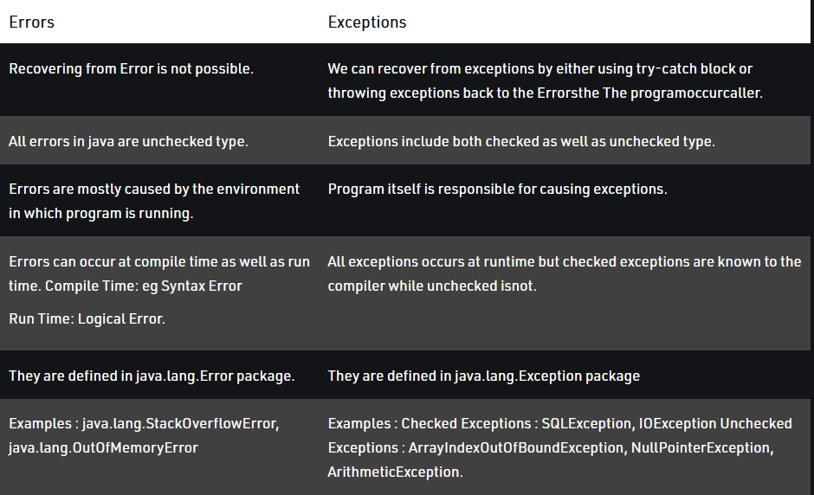
There are the below points that differentiate between both terms:

Slide 39
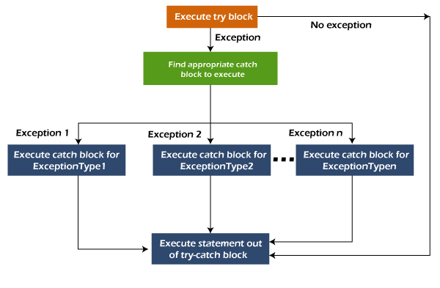
Multiple Catch :
A try block can be followed by one or more catch blocks. Each catch block must contain a different exception handler. So, if you have to perform different tasks at the occurrence of different exceptions, use java multi-catch block.
Points to remember
At a time only one exception occurs and at a time only one catch block is executed.
All catch blocks must be ordered from most specific to most general, i.e. catch for ArithmeticException must come before catch for Exception.

Slide 40
public class MultipleCatchBlock1 {
public static void main(String[] args) {
try{
int a[]=new int[5];
a[5]=30/0;
}
catch(ArithmeticException e)
{
System.out.println("Arithmetic Exception occurs");
}
catch(ArrayIndexOutOfBoundsException e)
{
System.out.println("ArrayIndexOutOfBounds Exception occurs");
}
catch(Exception e)
{
System.out.println("Parent Exception occurs");
}
System.out.println("rest of the code");
}
}

Slide 41
Using throw:
The throw keyword in Java is used to explicitly throw an exception from a method or any block of code. We can throw either checked or unchecked exception. The throw keyword is mainly used to throw custom exceptions.
Syntax:
throw Instance
Example: throw new ArithmeticException("/ by zero");

Slide 42
// Java program that demonstrates the use of throw
class ThrowExcep
{
static void fun()
{
try
{
throw new NullPointerException("demo");
}
catch(NullPointerException e)
{
System.out.println("Caught inside fun().");
throw e; // rethrowing the exception
}
}
output:
public static void main(String args[]) Caught inside fun().
Caught in main.
{
try
{
fun();
}
catch(NullPointerException e)
{
System.out.println("Caught in main.");
}
}
}

Slide 43
Using throws:
throws is a keyword in Java which is used in the signature of method to indicate that this method might throw one of the listed type exceptions. The caller to these methods has to handle the exception using a try-catch block.
Syntax:
type method_name(parameters) throws exception_list
exception_list is a comma separated list of all the exceptions which a method might throw.

Slide 44
Example:
class ThrowsExecp
{
static void fun() throws IllegalAccessException
{
System.out.println("Inside fun(). ");
throw new IllegalAccessException("demo");
}
public static void main(String args[])
{
try
{
fun();
}
catch(IllegalAccessException e)
{
System.out.println("caught in main.");
}
}
}
Output:
Inside fun().
caught in main.

Slide 45
Re-throwing An Exception :
We all know that exceptions occurred in the try block are caught in catch block. Thus caught exceptions can be re-thrown using throw keyword. Re-thrown exception must be handled some where in the program, otherwise program will terminate abruptly. For example,
public class ExceptionHandling
{
public static void main(String[] args)
{
try
{
methodWithThrow();
}
catch(NullPointerException ex)
{
System.out.println("NullPointerException Re-thrown in methodWithThrow() method will be handled here");
}
}
static void methodWithThrow()
{
try
{
String s = null;
System.out.println(s.length()); //This statement throws NullPointerException
}
catch(NullPointerException ex)
{
System.out.println("NullPointerException is caught here");
throw ex; //Re-throwing NullPointerException
}
}
}

Slide 46
Throwable Class:
The Throwable class is the superclass of every error and exception in the Java language.
Only objects that are one of the subclasses this class are thrown by any “Java Virtual Machine”
or may be thrown by the Java throw statement.
1. getMessage(): returns the message string about the exception.
Syntax: public String getMessage()
2. getCause(): returns the cause of the exception. It will return null is cause is unknown or non-existent.
Syntax : public Throwable getCause()
3. toString(): returns a short description of the exception.
Discription of the exception = class name + “: “ + message.
Syntax: public String toString()
4. printStackTrace(): prints the short description of the exception(using toString()) + a stack trace for this exception on the error output stream(System.err).
Syntax: public void printStackTrace(PrintStream s)

Slide 47
Example:
ExceptionHandlingExample.java
/*This program is used to show the use of Commonly used methods of Throwable class */
class ArithmaticTest
{
public void division(int num1, int num2)
{
try{
System.out.println(num1/num2);
}
catch(ArithmeticException e)
{
System.out.println("getMessage(): " + e.getMessage());
System.out.println("getCause(): " + e.getCause());
System.out.println("toString(): " + e.toString());
System.out.println("printStackTrace(): ");
e.printStackTrace();
}
}
}
public class ExceptionHandlingExample
{
public static void main(String args[])
{
ArithmaticTest obj = new ArithmaticTest();
obj.division(20, 0);
}
}
OUTPUT:
getMessage(): / by zero
getCause(): null
toString(): java.lang.ArithmeticException: / by zero
printStackTrace():
java.lang.ArithmeticException: / by zero
at com.w3spoint.business.ArithmaticTest.division
(ExceptionHandlingExample.java:17)
at com.w3spoint.business.ExceptionHandlingExample.main
(ExceptionHandlingExample.java:38)

Slide 48
Java finally block:
Java finally block is a block used to execute important code such as closing the connection, etc.
Java finally block is always executed whether an exception is handled or not. Therefore, it contains all the necessary statements that need to be printed regardless of the exception occurs or not.
The finally block follows the try-catch block.
Why use Java finally block?
finally block in Java can be used to put "cleanup" code such as closing a file, closing connection, etc.
The important statements to be printed can be placed in the finally block.
Usage of Java finally
Let's see the different cases where Java finally block can be used.

Slide 49
Case 1: When an exception does not occur
Let's see the below example where the Java program does not throw any exception, and the finally block is executed after the try block.
class TestFinallyBlock {
public static void main(String args[]){
try{
//below code do not throw any exception
int data=25/5;
System.out.println(data);
}
//catch won't be executed
catch(NullPointerException e){
System.out.println(e);
}
//executed regardless of exception occurred or not
finally {
System.out.println("finally block is always executed");
}
System.out.println("rest of phe code...");
}
}

Slide 50
Case 2: When an exception occurr but not handled by the catch block
Let's see the the fillowing example. Here, the code throws an exception however the catch block cannot handle it. Despite this, the finally block is executed after the try block and then the program terminates abnormally.
public class TestFinallyBlock1{
public static void main(String args[]){
try {
System.out.println("Inside the try block");
//below code throws divide by zero exception
int data=25/0;
System.out.println(data);
}
//cannot handle Arithmetic type exception
//can only accept Null Pointer type exception
catch(NullPointerException e){
System.out.println(e);
}
//executes regardless of exception occured or not
finally {
System.out.println("finally block is always executed");
}
System.out.println("rest of the code...");
}
}

Slide 51
Case 3: When an exception occurs and is handled by the catch block
Example:
Let's see the following example where the Java code throws an exception and the catch block handles the exception. Later the finally block is executed after the try-catch block. Further, the rest of the code is also executed normally.
public class TestFinallyBlock2{
public static void main(String args[]){
try {
System.out.println("Inside try block");
//below code throws divide by zero exception
int data=25/0;
System.out.println(data);
}
//handles the Arithmetic Exception / Divide by zero exception
catch(ArithmeticException e){
System.out.println("Exception handled");
System.out.println(e);
}
//executes regardless of exception occured or not
finally {
System.out.println("finally block is always executed");
}
System.out.println("rest of the code...");
}
}
Rule: For each try block there can be zero or more catch blocks, but only one finally block.
Note: The finally block will not be executed if the program exits (either by calling System.exit() or by causing a fatal error that causes the process to abort).

Slide 52
Creating Exception Sub classes:
Java provides rich set of built-in exception classes like: ArithmeticException, IOException, NullPointerException etc. all are available in the java.lang package and used in exception handling. These exceptions are already set to trigger on pre-defined conditions such as when you divide a number by zero it triggers ArithmeticException.
Apart from these classes, Java allows us to create our own exception class to provide own exception implementation. These type of exceptions are called user-defined exceptions or custom exceptions.
You can create your own exception simply by extending java Exception class. You can define a constructor for your Exception (not compulsory) and you can override the toString() function to display your customized message on catch. Lets see an example.

Slide 53
we are creating an exception class MyException that extends the Java Exception class
class MyException extends Exception
{
private int ex;
MyException(int a)
{
ex = a;
}
public String toString()
{
return "MyException[" + ex +"] is less than zero";
}
}
class Demo
{
static void sum(int a,int b) throws MyException
{
if(a<0)
{
throw new MyException(a); //calling constructor of user-defined exception class
}
else
{
System.out.println(a+b);
}
}
public static void main(String[] args)
{
try
{
sum(-10, 10);
}
catch(MyException me)
{
System.out.println(me); //it calls the toString() method of user-defined Exception
}
}
}
Output:
MyException[-10] is less than zero

Slide 54
Points to Remember while creating exception sub classes:
Extend the Exception class to create your own exception class.
You don't have to implement anything inside it, no methods are required.
You can have a Constructor if you want.
You can override the toString() function, to display customized message.

Slide 55
Thank you

